Slide 1
Changes in lectures
06.05.2019 (No lecture) -> Move to the next week

Slide 2
Data storage

Slide 3
Data and File Storage Overview
Android provides several options for you to save your app data. The solution you choose depends on your specific needs, such as how much space your data requires, what kind of data you need to store, and whether the data should be private to your app or accessible to other apps and the user.

Slide 4
the different data storage options available on Android:
Internal file storage: Store app-private files on the device file system.
External file storage: Store files on the shared external file system. This is usually for sharared user files, such as photos.
Shared preferences: Store private primitive data in key-value pairs.
Databases: Store structured data in a private database

Slide 5
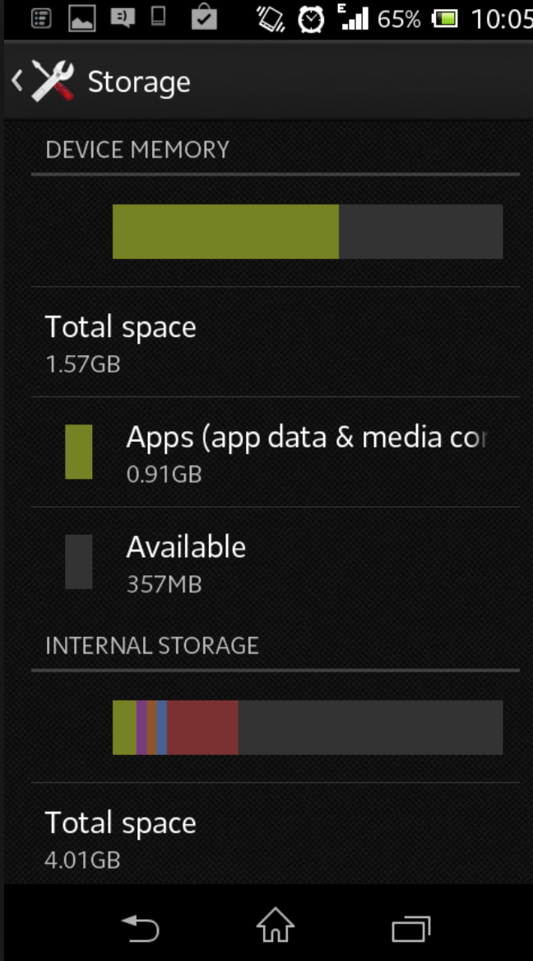
Internal storage

Slide 6
Internal storage
By default, files saved to the internal storage are private to your app, and other apps cannot access them (nor can the user, unless they have root access). This makes internal storage a good place for internal app data that the user doesn't need to directly access. The system provides a private directory on the file system for each app where you can organize any files your app needs.
When the user uninstalls your app, the files saved on the internal storage are removed. Because of this behavior, you should not use internal storage to save anything the user expects to persist independenly of your app. For example, if your app allows users to capture photos, the user would expect that they can access those photos even after they uninstall your app. So you should instead save those types of files to the public external storage.

Slide 7
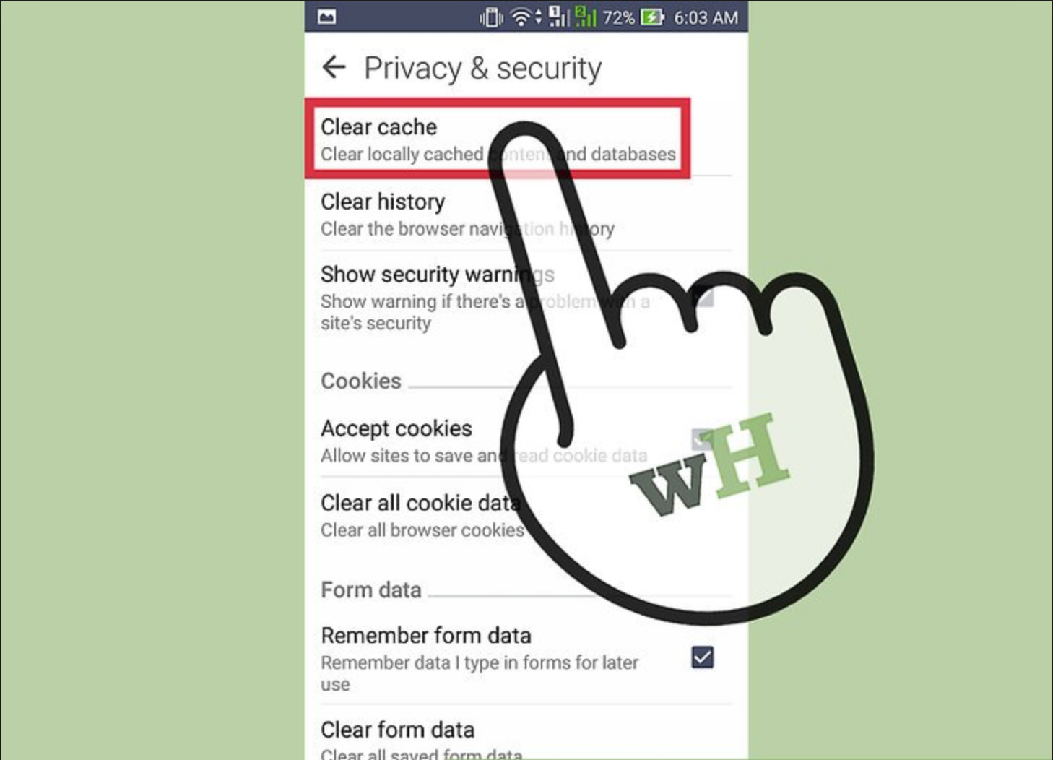
Cache folder

Slide 8
Internal cache files
If you'd like to keep some data temporarily, rather than store it persistently, you should use the special cache directory to save the data. Each app has a private cache directory specifically for these kinds of files. When the device is low on internal storage space, Android may delete these cache files to recover space. However, you should not rely on the system to clean up these files for you. You should always maintain the cache files yourself and stay within a reasonable limit of space consumed, such as 1MB. When the user uninstalls your app, these files are removed.

Slide 9
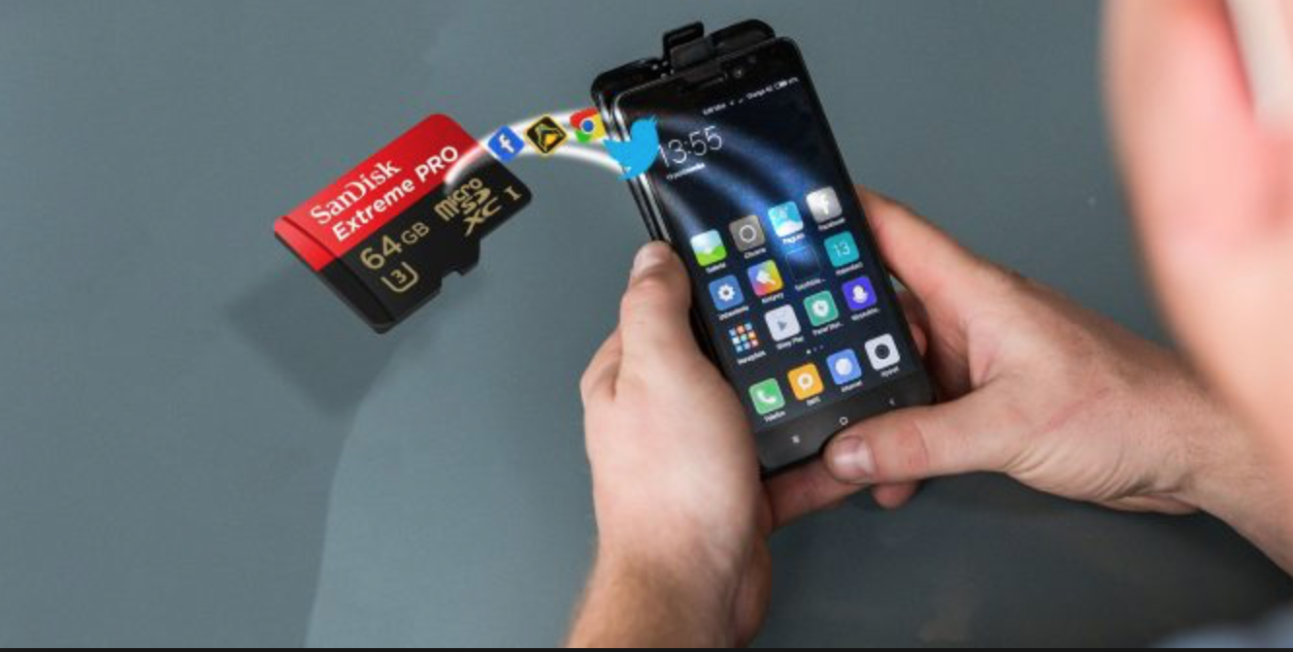
External storage

Slide 10
External storage
Every Android device supports a shared "external storage" space that you can use to save files. This space is called external because it's not a guaranteed to be accessible—it is a storage space that users can mount to a computer as an external storage device, and it might even be physically removable (such as an SD card). Files saved to the external storage are world-readable and can be modified by the user when they enable USB mass storage to transfer files on a computer.
So before you attempt to access a file in external storage in your app, you should check for the availability of the external storage directories as well as the files you are trying to access.
Most often, you should use external storage for user data that should be accessible to other apps and saved even if the user uninstalls your app, such as captured photos or downloaded files. The system provides standard public directories for these kinds of files, so the user has one location for all their photos, ringtones, music, and such.
You can also save files to the external storage in an app-specific directory that the system deletes when the user uninstalls your app. This might be a useful alternative to internal storage if you need more space, but the files here aren't guaranteed to be accessible because the user might remove the storage SD card. And the files are still world readable; they're just saved to a location that's not shared with other apps

Slide 11
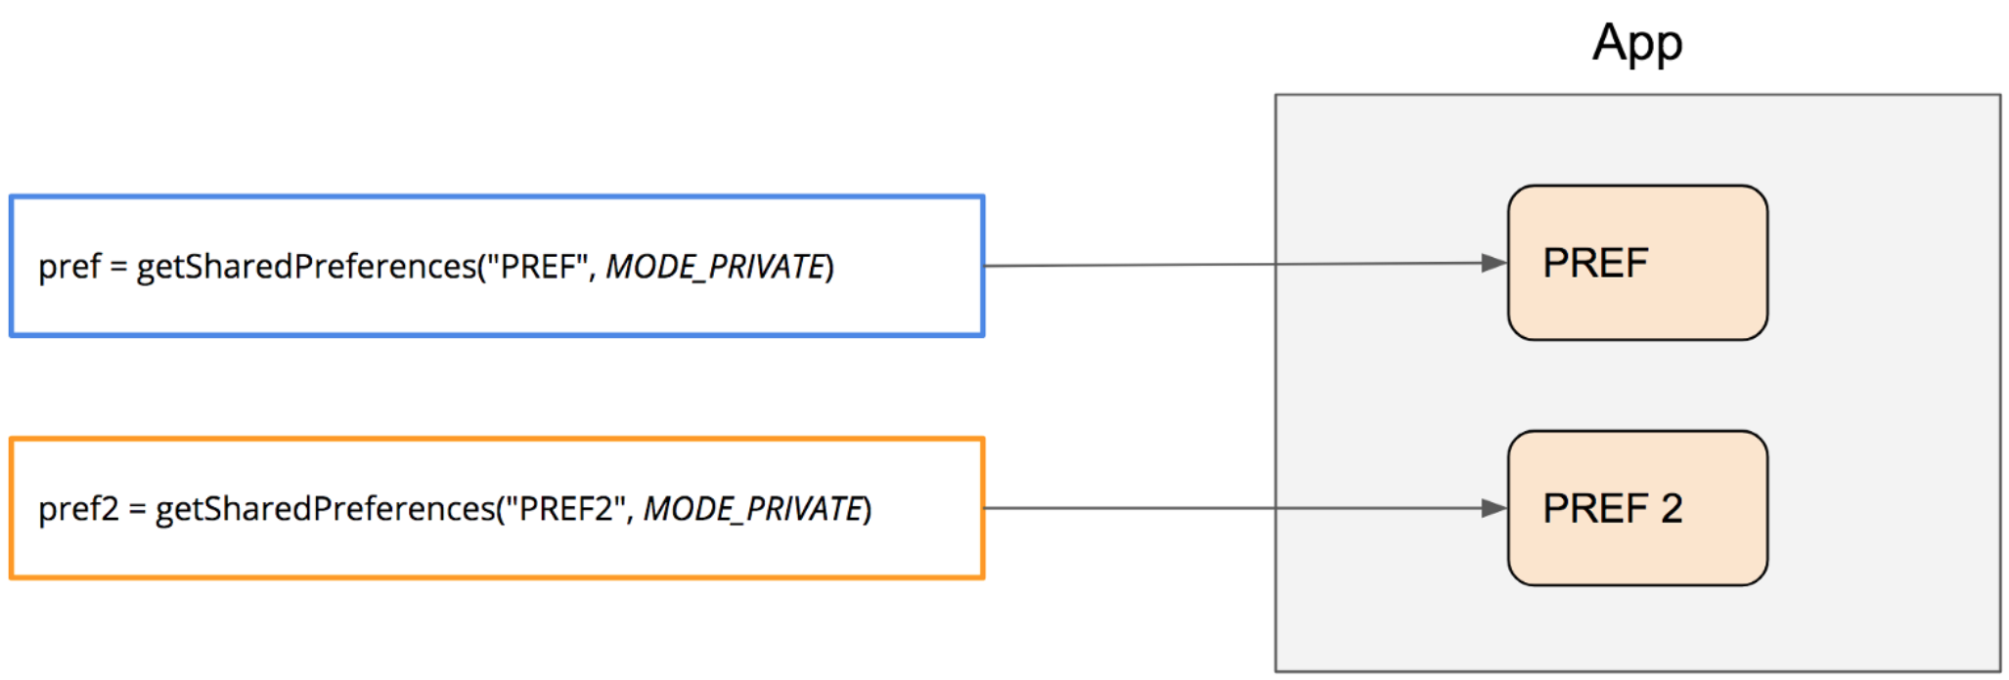
Shared preferences

Slide 12
Shared preferences
If you don't need to store a lot of data and it doesn't require structure, you should use SharedPreferences. The SharedPreferences APIs allow you to read and write persistent key-value pairs of primitive data types: booleans, floats, ints, longs, and strings.
The key-value pairs are written to XML files that persist across user sessions, even if your app is killed. You can manually specify a name for the file or use per-activity files to save your data.
The API name "shared preferences" is a bit misleading because the API is not strictly for saving "user preferences," such as what ringtone a user has chosen. You can use SharedPreferences to save any kind of simple data, such as the user's high score. However, if you do want to save user preferences for your app, then you should read how to create a settings UI, which uses PreferenceActivity to build a settings screen and automatically persist the user's settings.

Slide 13
Choose internal or external storage
All Android devices have two file storage areas: "internal" and "external" storage. These names come from the early days of Android, when most devices offered built-in non-volatile memory (internal storage), plus a removable storage medium such as a micro SD card (external storage). Many devices now divide the permanent storage space into separate "internal" and "external" partitions. So even without a removable storage medium, these two storage spaces always exist, and the API behavior is the same regardless of whether the external storage is removable.

Slide 14
Because the external storage might be removable, there are some differences between these two options as follows.
Internal storage:
It's always available.
Files saved here are accessible by only your app.
When the user uninstalls your app, the system removes all your app's files from internal storage.
Internal storage is best when you want to be sure that neither the user nor other apps can access your files.
External storage:
It's not always available, because the user can mount the external storage as USB storage and in some cases remove it from the device.
It's world-readable, so files saved here may be read outside of your control.
When the user uninstalls your app, the system removes your app's files from here only if you save them in the directory from getExternalFilesDir().
External storage is the best place for files that don't require access restrictions and for files that you want to share with other apps or allow the user to access with a computer.

Slide 15
Query free space
If you know ahead of time how much data you're saving, you can find out whether sufficient space is available without causing an IOException by calling getFreeSpace() or getTotalSpace(). These methods provide the current available space and the total space in the storage volume, respectively. This information is also useful to avoid filling the storage volume above a certain threshold.
However, the system does not guarantee that you can write as many bytes as are indicated by getFreeSpace(). If the number returned is a few MB more than the size of the data you want to save, or if the file system is less than 90% full, then it's okay to proceed. Otherwise, you probably shouldn't write to storage.
Note: You aren't required to check the amount of available space before you save your file. You can instead try writing the file right away, then catch an IOException if one occurs. You may need to do this if you don't know exactly how much space you need. For example, if you change the file's encoding before you save it by converting a PNG image to JPEG, you won't know the file's size beforehand.

Slide 16

Databases

Slide 17
Databases
Android provides full support for SQLite databases. Any database you create is accessible only by your app. However, instead of using SQLite APIs directly, we recommend that you create and interact with your databases with the Room persistence library.

Slide 18
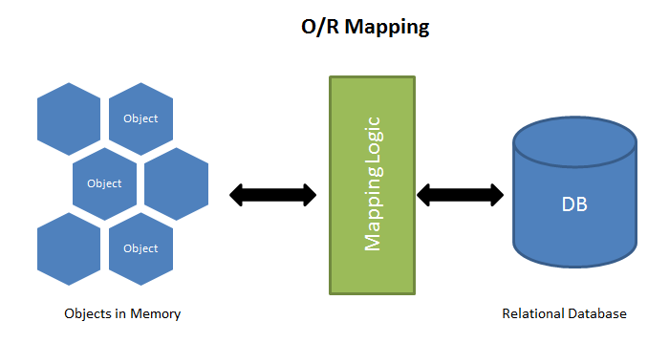
Room

Slide 19
The Room library
The Room library provides provides an object-mapping abstraction layer that allows fluent database access while harnessing the full power of SQLite.
Although you can still save data directly with SQLite, the SQLite APIs are fairly low-level and require a great deal of time and effort to use. For example:
There is no compile-time verification of raw SQL queries.
As your schema changes, you need to update the affected SQL queries manually. This process can be time consuming and error prone.
You need to write lots of boilerplate code to convert between SQL queries and Java data objects.

Slide 20
Secure place for storing sensitive data
https://github.com/yakivmospan/scytale

Slide 21
ORM
https://github.com/chennaione/sugar

Slide 22
Homework
Open MainAcitivty and read TODOs ☺

